Slide 1
AWS Lambda
Notes:
https://courses.cs.washington.edu/courses/cse403/13au/lectures/git.ppt.pdf
http://enos.itcollege.ee/~jpoial/allalaadimised/git/getting-started-with-git.pdf

Slide 2
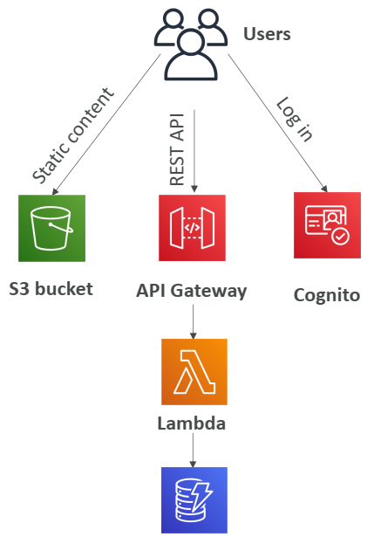
Serverless in AWS
AWS Lambda
DynamoDB
AWS Cognito
AWS API Gateway
Amazon S3
AWS SNS & SQS
AWS Kinesis Data Firehose
Aurora Serverless
Step Functions
Fargate

Slide 3
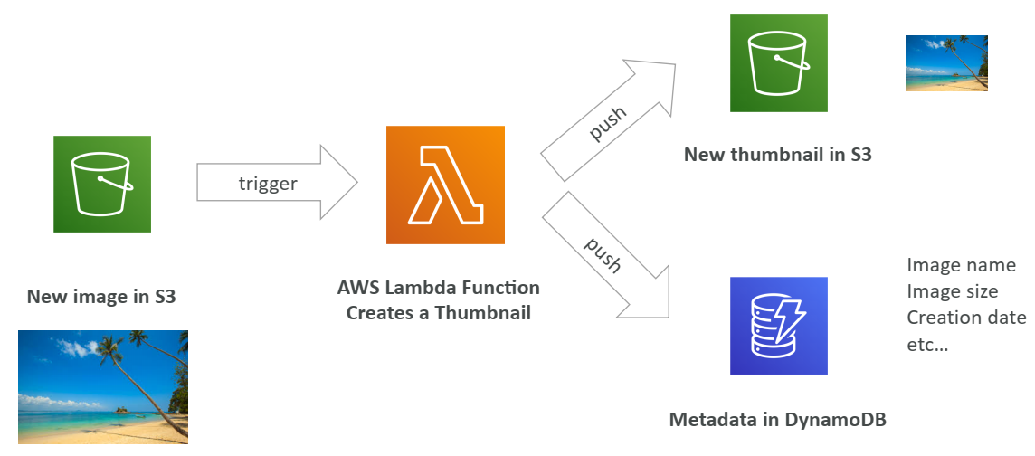
Example: Serverless Thumbnail creation

Slide 4
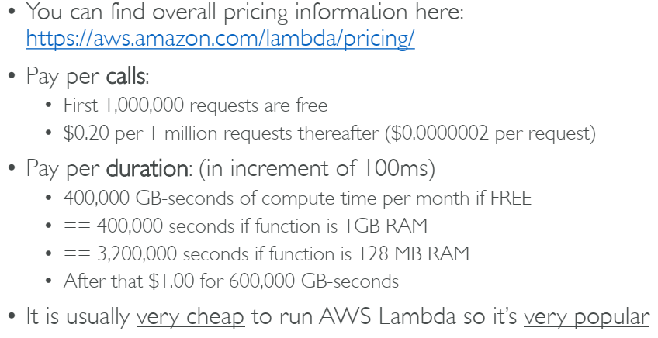
AWS Lambda Pricing: example

Slide 5
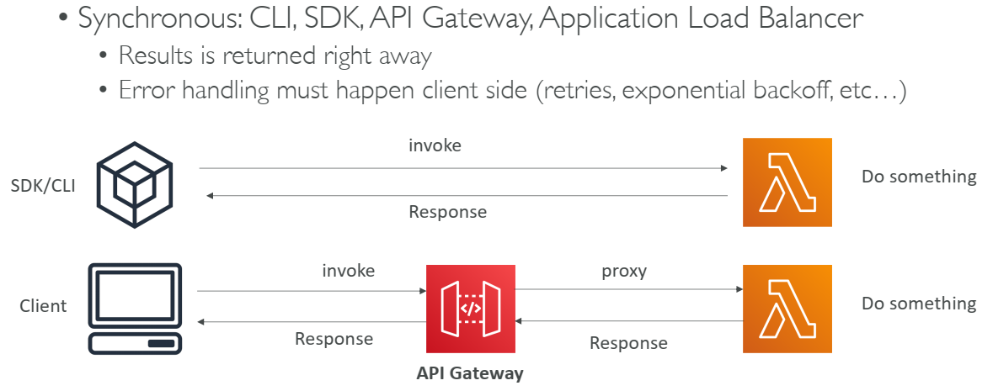
Lambda – Synchronous Invocations

Slide 6
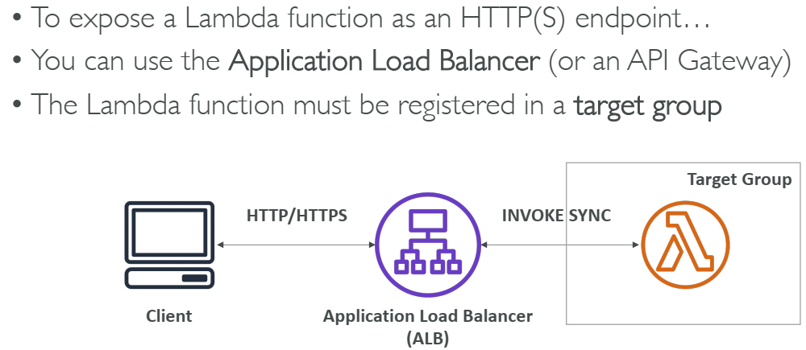
Lambda Integration with ALB

Slide 7
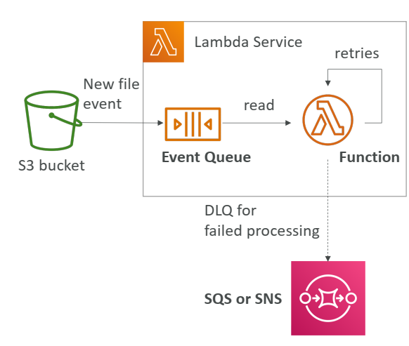
Lambda – Asynchronous Invocations

Slide 8
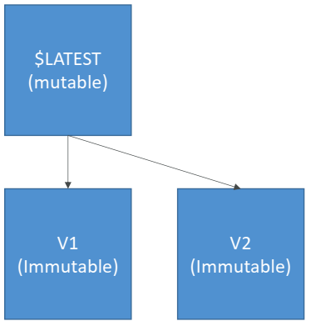
AWS Lambda Versions

Slide 9
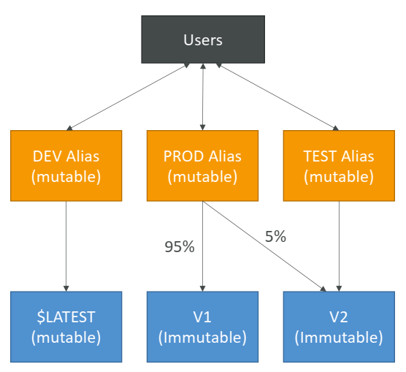
AWS Lambda Aliases

Slide 10
AWS Lambda Limits to Know - per region
Execution:
Memory allocation: 128 MB – 3008 MB (64 MB increments)
Maximum execution time: 900 seconds (15 minutes)
Environment variables (4 KB)
Disk capacity in the “function container” (in /tmp): 512 MB
Concurrency executions: 1000 (can be increased)
Deployment:
Lambda function deployment size (compressed .zip): 50 MB
Size of uncompressed deployment (code + dependencies): 250 MB
Can use the /tmp directory to load other files at startup
Size of environment variables: 4 KB

Slide 11
Thanks

